Slide 1
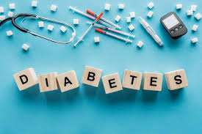
Diabetes Data Analysis
Ali Haider

Slide 2
Outline
Problem Statement
Understanding Dataset
Preprocessing
Model Training
Evaluation Metrics

Slide 3


Slide 4
Problem statement
Classify the women based on the provided features into those who are diabetes patients and those who are not.

Slide 5
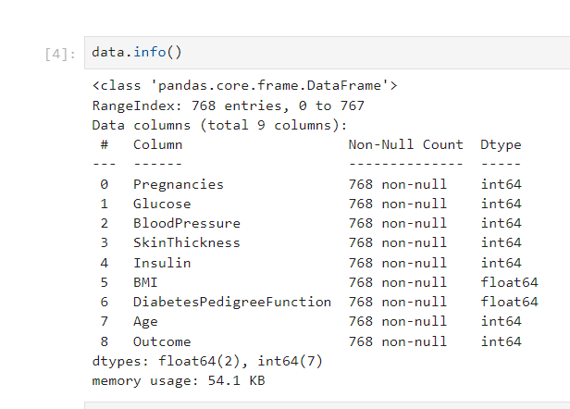
Understanding Data
All features are used to predict the outcome.
Outcome is the targeted data.
These features are used to categorize either a woman have diabetes or not.

Slide 6
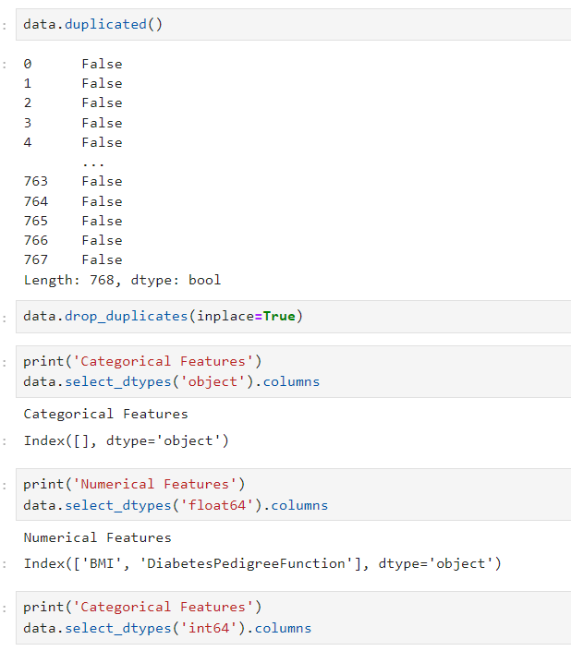
Pre processing
Tackle with the NaN (Null value).
See if there are any Ordinal series in dataset, do feature engineering.
If the data is too spreaded, normalize it.
Drop the duplicated data.
Etc.

Slide 7
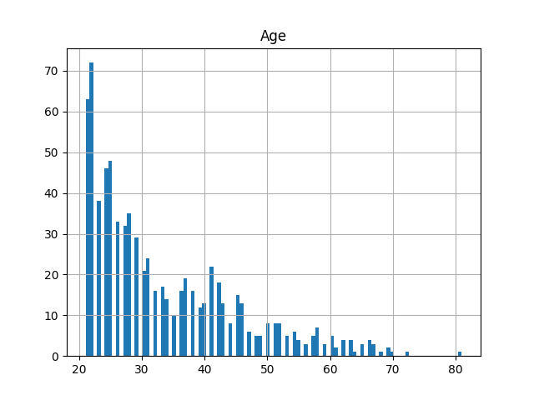
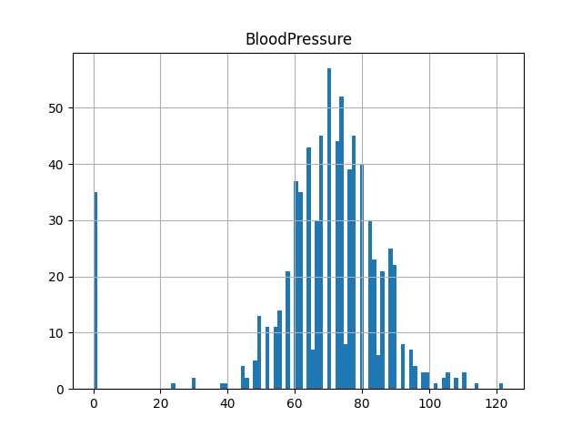
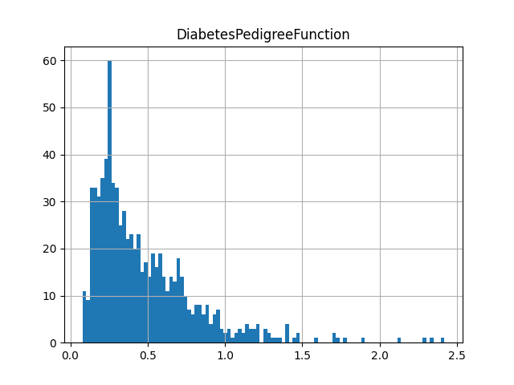
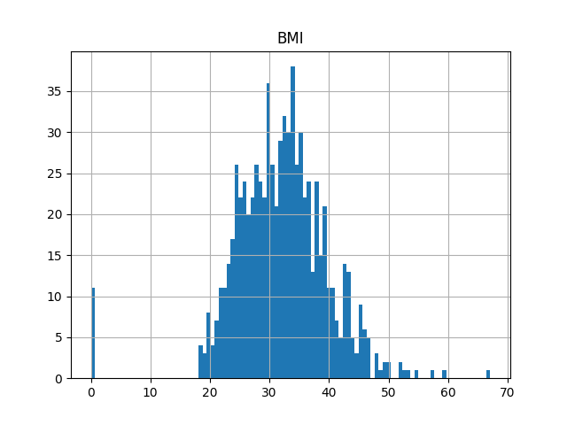

Slide 8
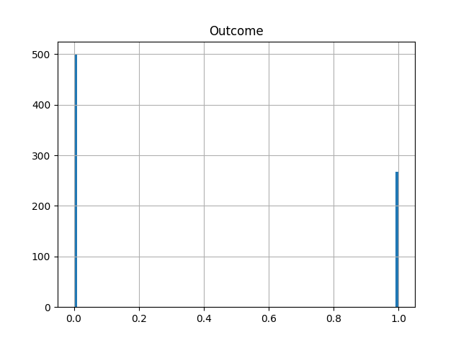
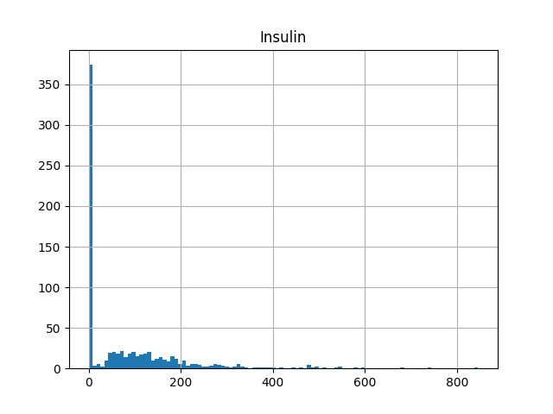
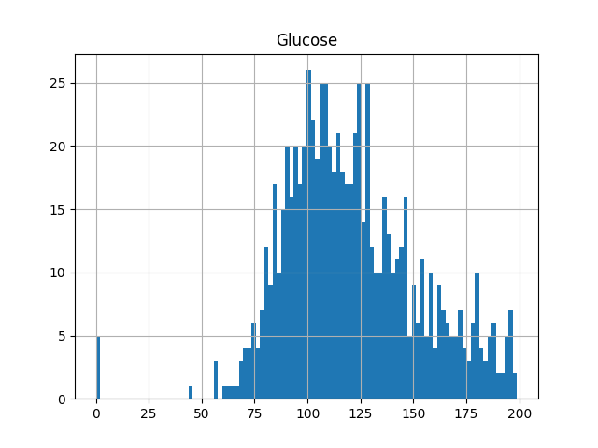
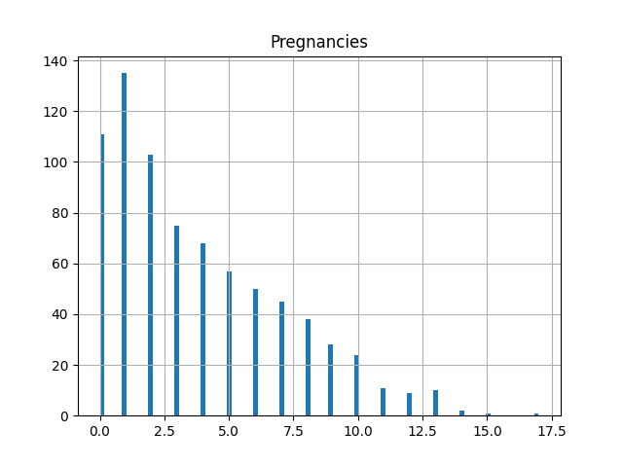

Slide 9
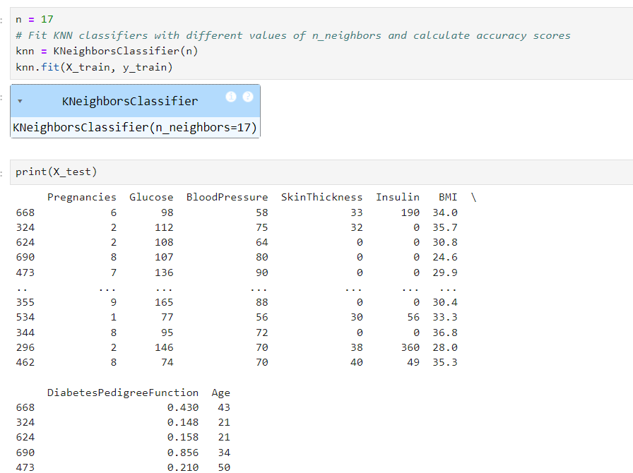
Model Training
K Nearest Neighbors
The k-nearest neighbors algorithm, also known as KNN or k-NN, is a non-parametric, supervised learning classifier, which uses proximity to make classifications or predictions about the grouping of an individual data point.
•While it can be used for either regression or classification problems, it is typically used as a classification algorithm, working off the assumption that similar points can be found near one another.

Slide 10
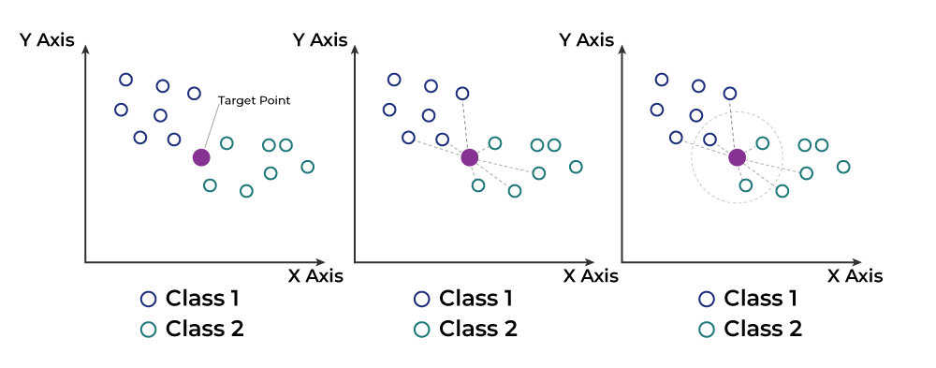

Slide 11
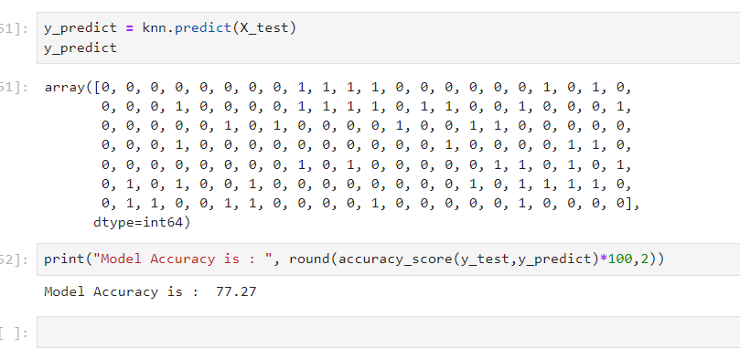
Evaluation Metrics
Accuracy Score
To check how much the predicted target and labeled target which were taken as testing data.
The accuracy of model will increase with the increase in the amount of dataset.

Slide 12


Slide 13


